Slide 1


Data analysis

Slide 2


Agenda
Data cleaning & Preparation
Data analysis use formula
Pivot table & chart
What-If analysis and goal seek
Dashboard creation

Slide 3

Data cleaning & preparation
About Dataset:
This dataset contains around 3,530 coffee sales transactions recorded in a Fourth COFFEE Cafe. It gives info about both customer and transaction details like time of purchase, method of payment, beverage type, and amount spent.
Data cleaning & preparation:
Split and merged column using “Text to Column”, CONCAT and LEFT/RIGHT for better data organization.
Removed duplicates, blanks, and inconsistencies to ensure data accuracy and reliability.
Handled missing values through imputation, replacement, or deletion based on relevance.
Applied filters and pivot tables to summarize, analyze, and verify data accuracy after cleaning.
Ensured final dataset readiness for reporting, visualization, or further analysis.

Slide 4
DATA analysis use formula
Quick totals & aggregates Total revenue (all rows) : =SUM(C2:C3548)
Total revenue for Card payments only : =SUMIF(B2:B3548,"Card",C2:C3548)
Count of transactions : =COUNTA(A2:A3548)
Revenue for a specific coffee: (e.g., "Latte"): =COUNTA(D2:3548,"Latte",C2:C3548) (e.g., "Cocoa"): =COUNTA (D2:3548," Cocoa",C2:C3548) (e.g., "Americano"): =COUNTA (D2:3548,"Americano",C2:C3548) (e.g., "Cappuccino"): =COUNTA (D2:3548,"Cappuccino",C2:C3548)
Revenue for Morning sales: =COUNTA (E2:E3548,"Morning",C2:C3548)
Revenue on a particular date (e.g., 3/1/2024): =COUNTA (J2:J3548,DATE(2024,3,1),C2:C3548)
Revenue for a coffee on a particular date (e.g., Latte on 3/1/2024): =COUNTA (C2:C3548, D2:D3548, "Latte", J2:J1000, DATE(2024,3,1))

Slide 5
Pivot table & chart
Total Sales by Coffee Type:
Purpose: Identify best-selling coffee varieties. Pivot Setup: Rows: Coffee name
Values: Sum of Money (rename as Total Sales)
2. Sales by Time of Day: Purpose: See when most sales occur — Morning, Afternoon, or Night.
Pivot Setup: Rows: Time of Day
Values: Sum of Money
3. Sales by Hour of Day: Purpose: Find the busiest selling hours.
Pivot Setup: Rows: Hour of day
Values: Sum of Money (rename as Total Sales)

Slide 6
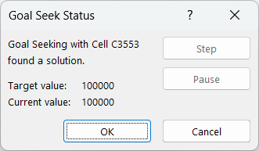
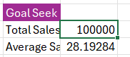
WHAT-if analysis & Goal seek
What-If Analysis helps you change input values in Excel formulas to see how those changes affect the result.
It includes 3 tools:
Scenario Manager
Goal Seek
Data Table
Example: Using “Goal Seek” Situation: You want to find how many cups of coffee (transactions) are needed to reach ₹10,000 in total sales. Create a formula cell for Total Sales: e.g., =SUM(Money)
Go to: Data → What-If Analysis → Goal Seek
In the dialog box: Set cell: cell with total sales formula
To value: 100000
By changing cell: the number of transactions or average sale per item (you can create a variable cell like “Average Money per Order”)
Click OK

Slide 7
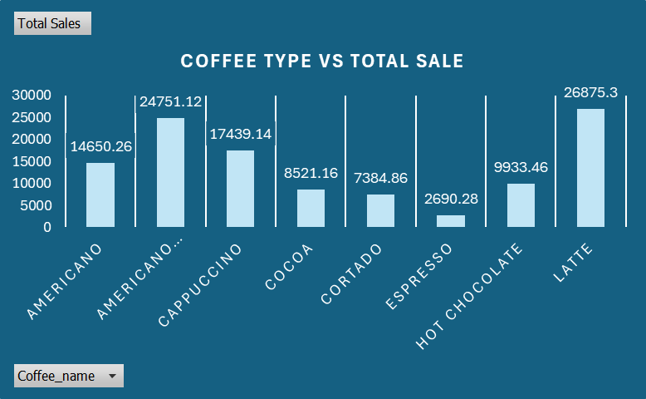
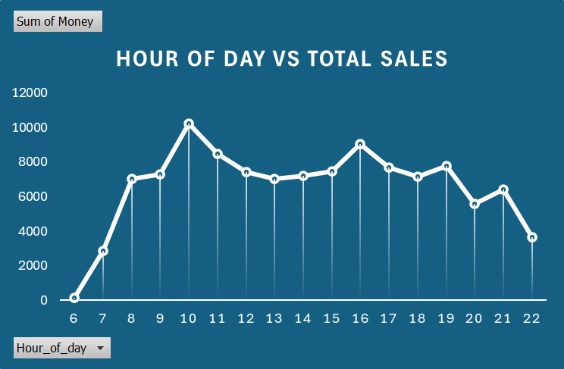
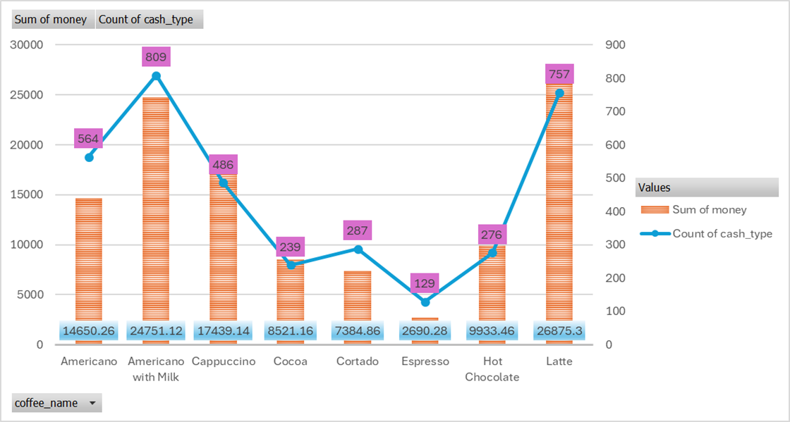
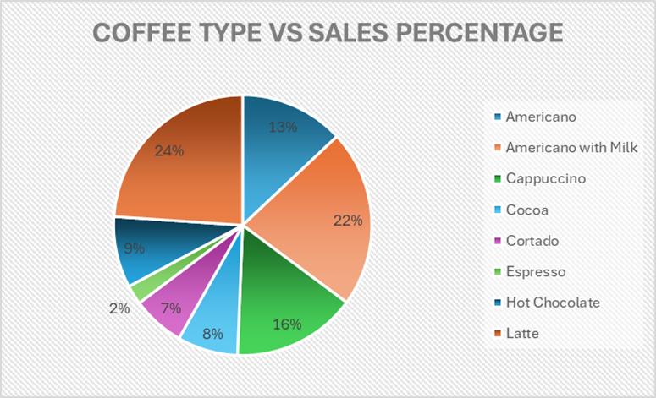
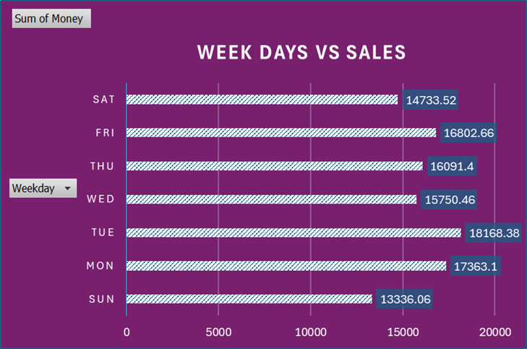
Dashboard creation
COLUMN CHART
LINE CHART
COMBO CHART
PIE CHART
BAR CHART

Slide 8


Thank you
By
VARSHINI

